Slide 1

DAYANANDA SAGAR UNIVERSITY
SCHOOL OF ENGINEERING
Department of Artificial Intelligence & Robotics
PROJECT PRESENTATION
CATARACT PREDICTION
USING VGG19, ResNet50, MobileNetV2
Under the Supervision
of
Dr Bharath Kumar
Presented By:
Harshitha P (ENG23RA0008)
Chintha Deepak (EN23RA0029)
Dhanush S (ENG23RA0030)
Notes:
Title of the project
CSE Dept., SET-Jain University

Slide 2
Overview
Abstract
Problem Statement
Introduction
Social Impact
Literature Survey
Methodology
Architecture
Result
Conclusion
References
27/05/2025
Dept of Ai & Robotics, SOE-Dayananda Sagar University
<number> of 12

Slide 3
Abstract
Using the ODIR dataset with real-world fundus images and diagnostic labels.
Focus on classifying images as Normal or Cataract.
Applying deep learning for image classification.
Preprocessing and augmentation used to address image quality variations.
Goal: Build an accurate model for Cataract detection from eye images.
27/05/2025
Dept of Ai & Robotics, SOE-Dayananda Sagar University
<number> of 12

Slide 4
Problem Statement
Manual cataract diagnosis is slow and prone to errors, especially in areas lacking skilled ophthalmologists. Automated deep learning models can speed up and improve the accuracy of cataract detection using retinal images.
This project uses CNN models like VGG19, ResNet50, and MobileNetV2 on the ODIR dataset. Transfer learning and image preprocessing help improve accuracy and reduce overfitting despite limited medical data.
Lightweight models such as MobileNetV2 enable faster and more efficient processing. Performance is measured with accuracy, precision, recall, and F1-score to ensure clinical reliability, offering a practical AI solution for early cataract detection.
27/05/2025
Dept of Ai & Robotics, SOE-Dayananda Sagar University
<number> of 12

Slide 5
Introduction
Cataract is one of the leading causes of vision loss globally.
Scope: Binary classification from fundus images.
Plan: Use transfer learning with three CNN architectures.
Assumptions: Sufficient training data and high-quality annotations.
27/05/2025
Dept of Ai & Robotics, SOE-Dayananda Sagar University
<number> of 12

Slide 6
Social Impact
Supports Public Health Initiatives: Can assist in large-scale community eye health programs and awareness campaigns.
Speeds Up Diagnosis: The AI model instantly analyses fundus images, helping doctors quickly identify cataract cases. Reduces time spent per patient, especially useful in high-volume clinics.
Improved Access to Eye Care: Enables early cataract detection in rural and underserved areas with limited access to ophthalmologists.
Reduces Preventable Blindness: Timely diagnosis can prevent vision loss, improving quality of life.
Cost-Effective Screening: Reduces the need for expensive manual screening and hospital visits.
27/05/2025
Dept of Ai & Robotics, SOE-Dayananda Sagar University
<number> of 12

Slide 7
Literature Survey
Author’s Name / Paper Title | Conference / Journal Name and Year | Technology / Design | Results shared by author | What you infer
A. Kumar et al., Cataract Detection | IEEE Access, 2020 | ResNet50 | 85% Accuracy | CNNs work well for medical image analysis
B. Lee et al., Eye Disease Detection | Elsevier CBM, 2021 | MobileNetV2 | 88% Accuracy | Efficient for mobile-based screening
S. Zhang et al., Ocular Image Analysis | Springer, 2022 | VGG16 + Ensemble | 90% Accuracy | Ensemble models improve performance
Dept of CSE., SOE-Dayananda Sagar University
<number> of 12

Slide 8
D. Singh et al., Fundus Image Classification | D. Singh et al., Fundus Image Classification | D. Singh et al., Fundus Image Classification | D. Singh et al., Fundus Image Classification | D. Singh et al., Fundus Image Classification
Y. Chen et al., Deep Learning for Cataracts | IEEE JBHI, 2019 | InceptionV3 | 87% Accuracy | Complex architectures can capture subtle features
This Work | - | VGG19, ResNet50, MobileNetV2 | 94.4 accuracy 96.7 accuracy 93.5 accuracy | Comparative study of popular CNN models
27/05/2025
Dept of Ai & Robotics, SOE-Dayananda Sagar University
(#) of 12

Slide 9
Methodology
This project uses CNN models (VGG19, ResNet50, MobileNetV2) for cataract prediction.
The ODIR dataset of fundus images is used for training and testing.
Transfer learning is applied to improve model accuracy and efficiency.
Implemented in Python using TensorFlow/Keras.
Performance evaluated using accuracy, precision, recall, and F1-score.
Aims to assist ophthalmologists with fast, AI-powered diagnosis.
27/05/2025
Dept of Ai & Robotics, SOE-Dayananda Sagar University
(#) of 12

Slide 10
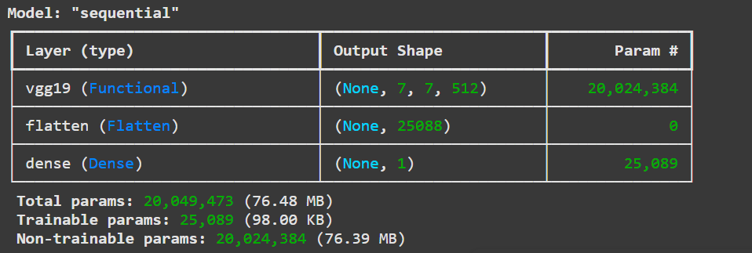
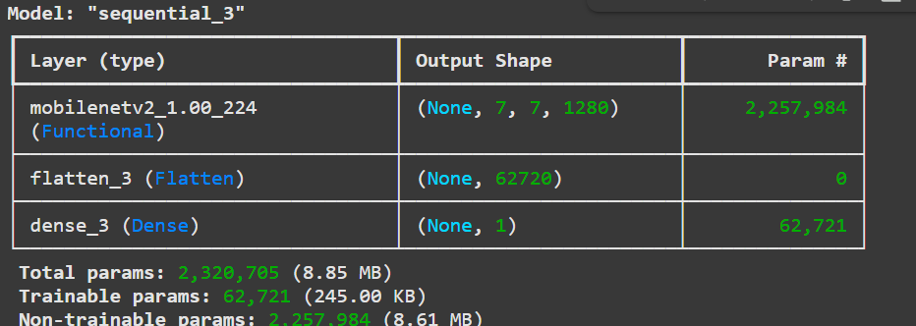
Architecture
Dept of CSE., SOE-Dayananda Sagar University
<number> of 12

Slide 11
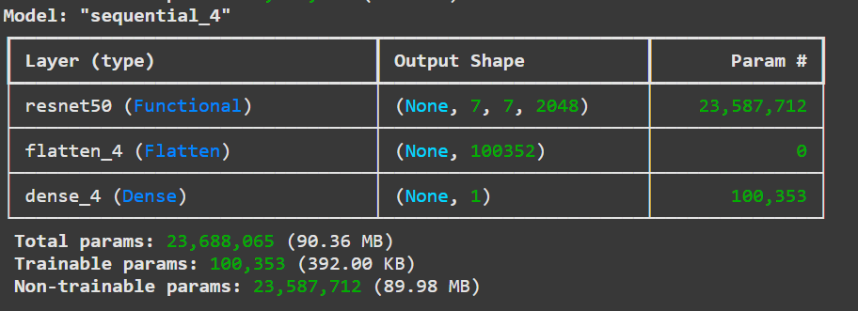
27/05/2025
Dept of Ai & Robotics, SOE-Dayananda Sagar University
(#) of 12

Slide 12
Implementation and Testing
Train/Test Split: 80-20
Loss Function: Binary Cross-Entropy for binary classification.
Optimizer: Adam optimizer for efficient training.
Epochs: 15 epochs to reach model convergence while preventing overfitting.
Metrics:
Accuracy: Overall performance measure.
Precision: Accuracy of positive predictions.
Recall: Ability to identify positive cases.
Evaluation:
Confusion Matrix: Visual representation of model predictions.
Classification Report: Detailed performance breakdown per class, including precision, recall, and F1-score.
27/05/2025
<number> of 12
Dept of Ai & Robotics, SOE-Dayananda Sagar University

Slide 13
Results
MODEL | ACCURACY | LOSS
VGG19 | 0.9724770642201835 | 0.21276697516441345
ResNet50 | 0.9862385321100917 | 0.11961647868156433
MobileNetV2 | 0.9541284403669725 | 0.23383110761642456
Inference Time
1.4109845161437988
0.6882505416870117
0.36947178840637207
27/05/2025
<number> of 12
Dept of Ai & Robotics, SOE-Dayananda Sagar University

Slide 14
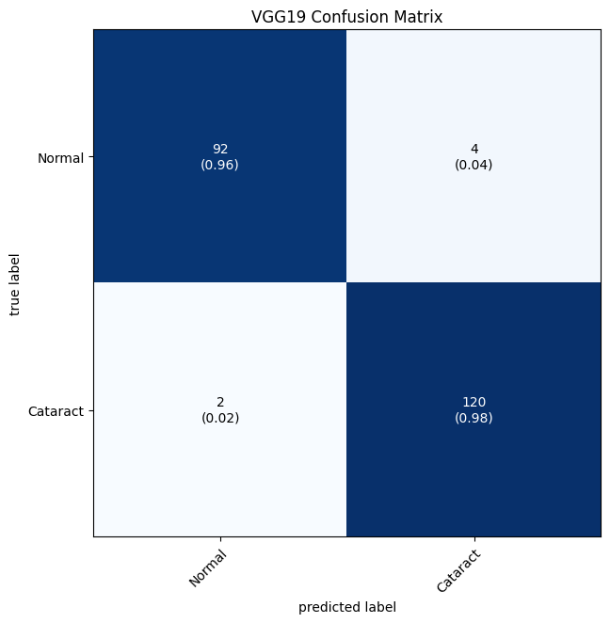

Confusion Matrix
27/05/2025
Dept of Ai & Robotics, SOE-Dayananda Sagar University
(#) of 12

Slide 15
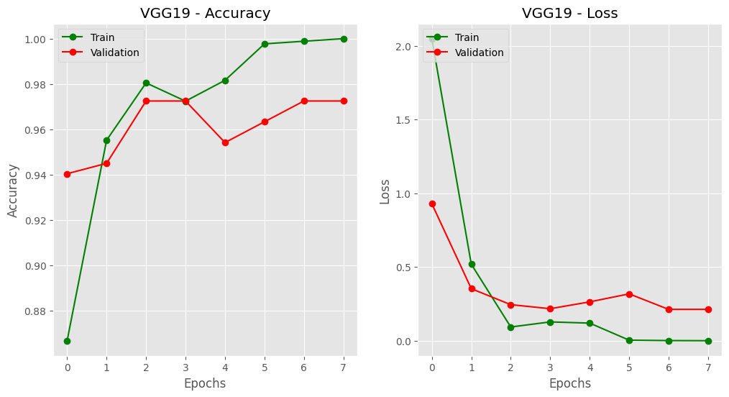

Accuracy & loss plots for VGG19
27/05/2025
Dept of Ai & Robotics, SOE-Dayananda Sagar University
(#) of 12

Slide 16
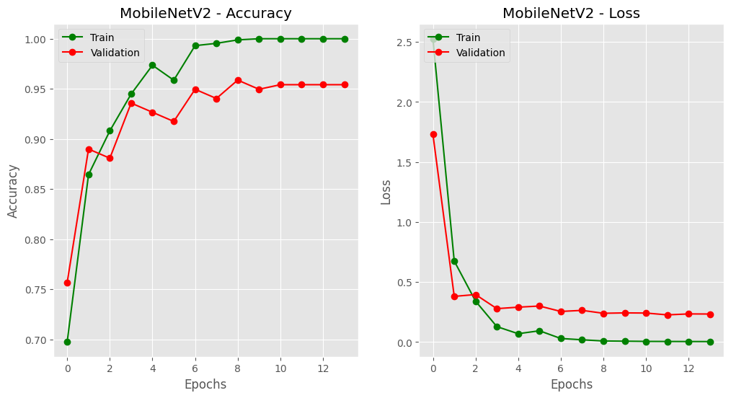
Accuracy & loss plots for MobileNetV2
27/05/2025
Dept of Ai & Robotics, SOE-Dayananda Sagar University
(#) of 12

Slide 17
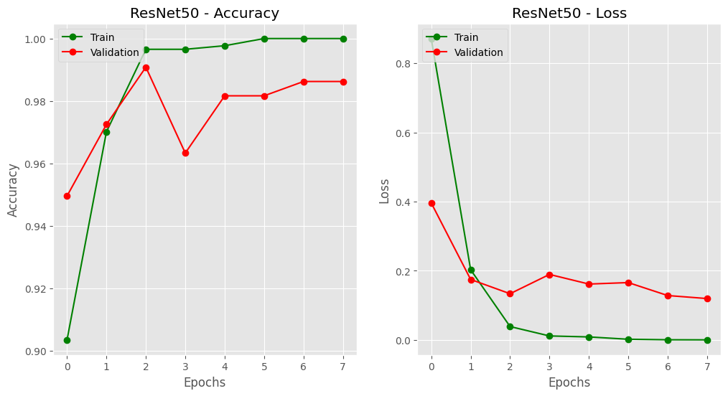
Accuracy & loss plots for ResNet50
27/05/2025
Dept of Ai & Robotics, SOE-Dayananda Sagar University
(#) of 12

Slide 18
Conclusion
Summary: MobileNetV2 gives best trade-off between accuracy and speed.
But if u focus only on accuracy then RestNet50 is best
Limitation: Dataset limited to specific demographics.
Future Work: Expand dataset, explore ensemble learning, deploy as a mobile/web app.
27/05/2025
<number> of 12
Dept of Ai & Robotics, SOE-Dayananda Sagar University

Slide 19
References
A. Kumar, S. Ghosh, and R. Singh, “Deep Learning-Based Cataract Detection Using Fundus Images,” IEEE Access, vol. 8, pp. 19172–19181, 2020.
B. Lee and H. Kim, “Automated Eye Disease Detection Using Lightweight CNNs,” Computers in Biology and Medicine, vol. 134, 104524, 2021.
S. Zhang, L. Wang, and J. Liu, “An Ensemble Approach for Ocular Disease Classification Using Fundus Images,” Springer Lecture Notes in Computer Science, vol. 12489, pp. 123–132, 2022.
27/05/2025
Dept of Ai & Robotics, SOE-Dayananda Sagar University
<number> of 12

Slide 20
Y. Chen, K. Lin, and M. Li, “Cataract Detection via Inception-V3 Deep Transfer Learning,” IEEE Journal of Biomedical and Health Informatics, vol. 23, no. 5, pp. 2031–2038, 2019.
D. Singh, A. Roy, and S. K. Pandey, “Fundus Image Classification Using DenseNet121 for Diabetic Retinopathy and Cataract,” Computers in Biology and Medicine, vol. 131, 104248, 2021.
This Work – Comparative Analysis of VGG19, ResNet50, and MobileNetV2 for Cataract Detection, 2025.
27/05/2025
Dept of Ai & Robotics, SOE-Dayananda Sagar University
(#) of 12

